Slide 1
Assignment-Discussion POS Tagging Using HMM
210050001, 3rd Year, CSE
210050126, 3rd Year, CSE
210040139, 3rd Year, Mech

Slide 2
Problem Statement
Given a sequence of words, produce the POS tag sequence
Technique to be used: HMM-Viterbi
Use Universal Tag Set (12 in number)
5-fold cross validation
Tag_List = {'NOUN', 'VERB','ADV', 'ADJ', 'PRT', 'DET', 'CONJ', '.', 'ADP', 'PRON', 'X', 'NUM’}

Slide 3
Overall performance
Precision : 0.9546080893951563
Recall : 0.9538759845493135
F-score (3 values)
F1-score: 0.9540233328995054
F0.5-score: 0.9543224882476086
F2-score: 0.9538815616660485

Slide 4
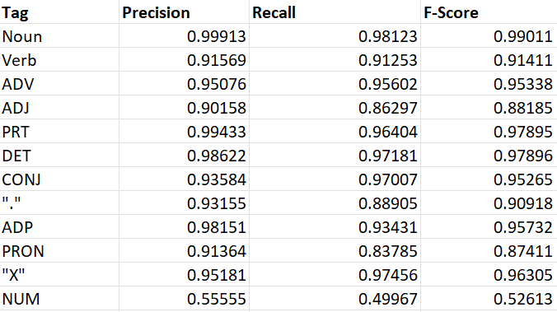
Per POS performance

Slide 5
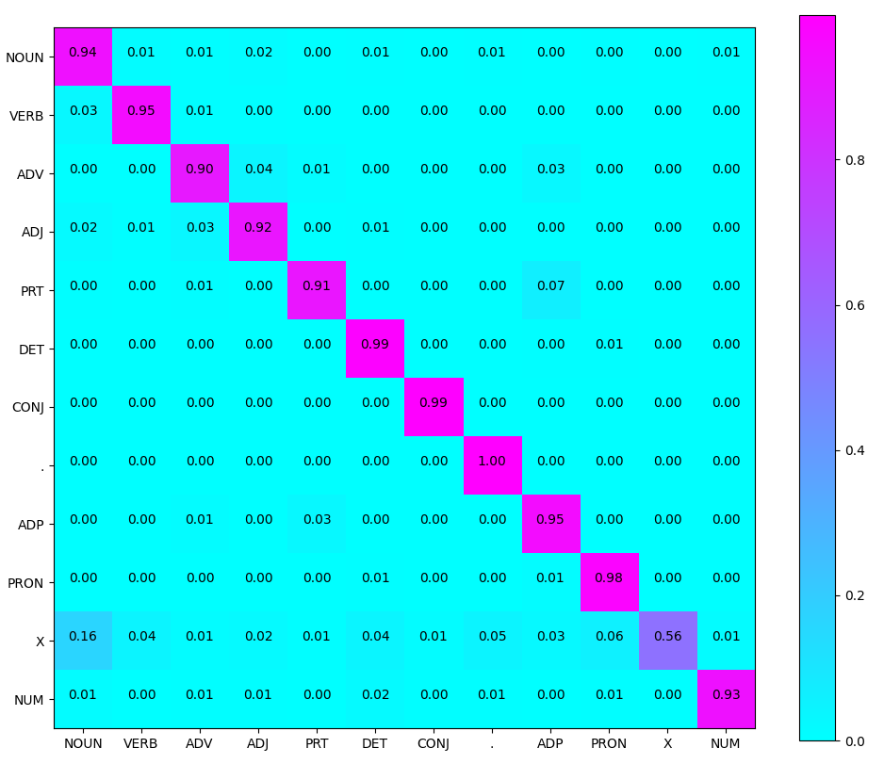
Confusion Matrix (12 X 12) (can give heat map)

Slide 6
Interpretation of confusion (error analysis)
<list maximal confusions; which tag is confused with which tag most>
<try giving reasons>

Slide 7
Data Processing Info (Pre-processing)
<for example, lower casing, tokenization, etc.>

Slide 8
Inferencing/Decoding Info
<Describe VERY briefly how you implemented Viterbi; not allowed to use any library or API>

Slide 9
Demo
Should have GUI

Slide 10
Marking Scheme
1. Demo working- 10/10 (if not, 0)
2. Implemented Viterbi and Clarity on Viterbi- 5/5
3. Transition and Lexical tables clearly described- 5/5
4. Confusion matrix drawn and error analysed- 5/5
5. Overall F-score > 90- 10/10, >80 & <=90- 8/10, else 6/10
6. Unknown word handling- done (5/5; else 0)

Slide 11
Any thoughts on generative vs. discriminative POS tagging

